Slide 1
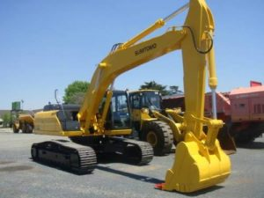
Sumitomo Sh290-3 Crawler Excavator Workshop Service Repair Manual
DOWNLOAD MANUAL HERE
This is a COMPLETE Solution Fixing Handbook for the SUMITOMO SH290-3 SPIDER EXCAVATOR. This handbook consists of deep details regarding preserving, setting up, disassembly and also servicing your SUMITOMO SPIDER EXCAVATOR.

